Slide 1
AIRLINE PRICE PREDICTION USING MACHINE LEARNING ALGORITHAMS
Data Analytics final project
Saran Jaya Thilak, Eldho Paulose, Binnies Pallimyalil Benny, Arjun Raj C

Slide 2
INDEX
Introduction
Data set
Methodology
Algorithm
Conclusion

Slide 3
INTRODUCTION
Why we choose this topic
To Predict ticket price for upcoming flights which helps in selecting the optimum time for travel and the cheapest flight to the desired destination

Slide 4
Why prediction is important
Give us insights into much vital information
Airlines: Increase profit by selling more tickets
Travelers: Buy tickets at a lower price and travels

Slide 5
DATA SET
Airline
Date of Journey
Source
Destination
Route
Departure Time
Arrival Time
Duration
Total Stops
Additional Info
Price

Slide 6
Choosing the dataset and analysing
Preprocessing
Handling missing data
Checking for categorical data
Feature Selection

Slide 7
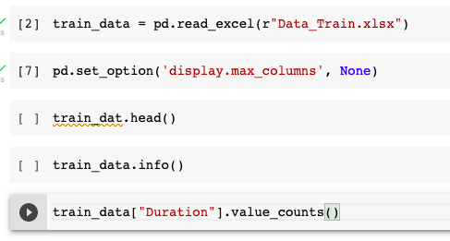
Splitting data into train and test dataset
The main idea of splitting the dataset into a validation set is to prevent our model from overfitting
Using train_test_split( ) from the dataset science library sci-kit-learn, we can split our dataset

Slide 8
METHODOLOGY
Regression techniques: Regression techniques consist of finding a mathematical relationship between measurements of two variables y and x, such that the value of variable y can be predicted from a measurement of the other variable x.

Slide 9
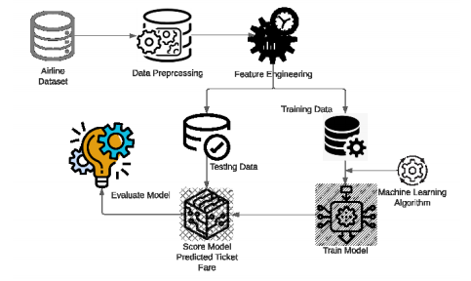
FLOW CHART
Chart

Slide 10
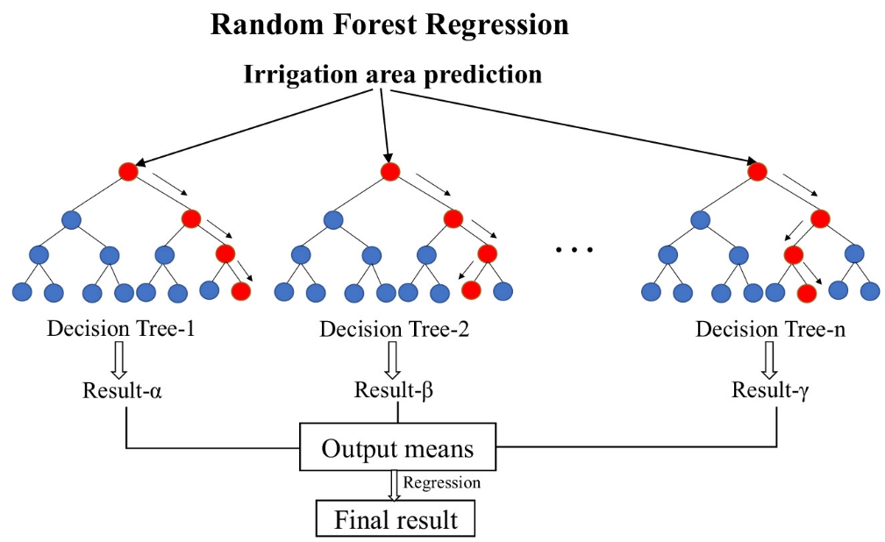
ALGORITHAMS
Extra tree regression
Randomized search CV
Random forest regression

Slide 11
Extra tree regression
Used to select important features of the Data set
To fit the model and avoid overfitting

Slide 12
Randomized search CV
Random combinations of the parameters are used to find the best solution for the model
Iteration is done with cross validation

Slide 13
Random forest regression
Ensembled Technique with multiple decision trees are used
Output means are used

Slide 14
Code

Slide 15
CONCLUSION
The airline price prediction model with 81% accuracy was generated with the random forest regression method.
Adding more features like including weekend prices would increase the prediction accuracy, so further studies are recommended.

Slide 16
BY
THANK YOU

